Slide 1
DISASTER RECOVERY WITH IBM CLOUD VIRTUAL SERVERS
Phase 3
Team Leader: S. Nandhini
Team Members:
M.Megalathangamani
D.Mavuriya
G.Kowsalya
G.Mounasakthi
A.Devika

Slide 2
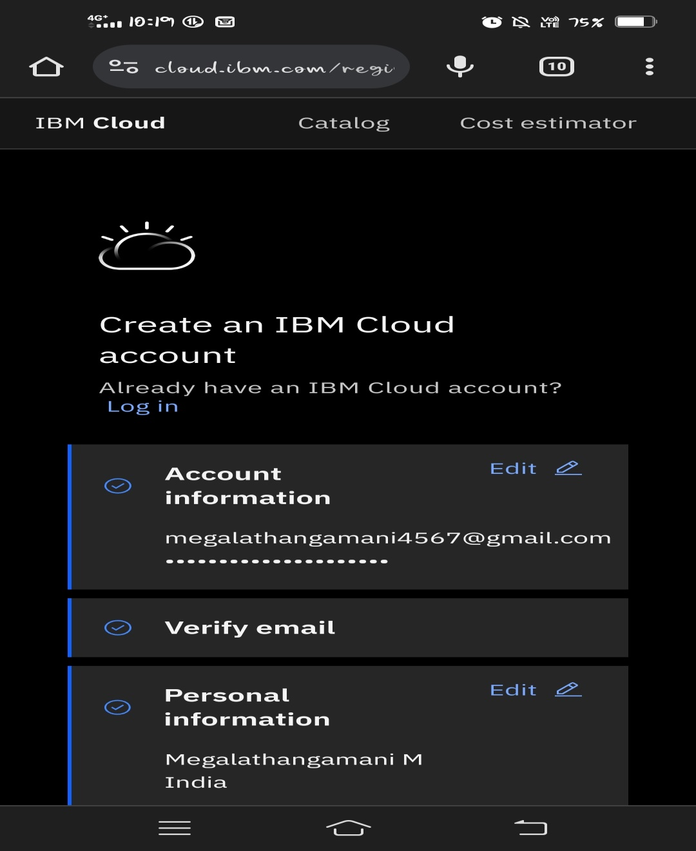
Step 1: Create an account in the IBM cloud.

Slide 3
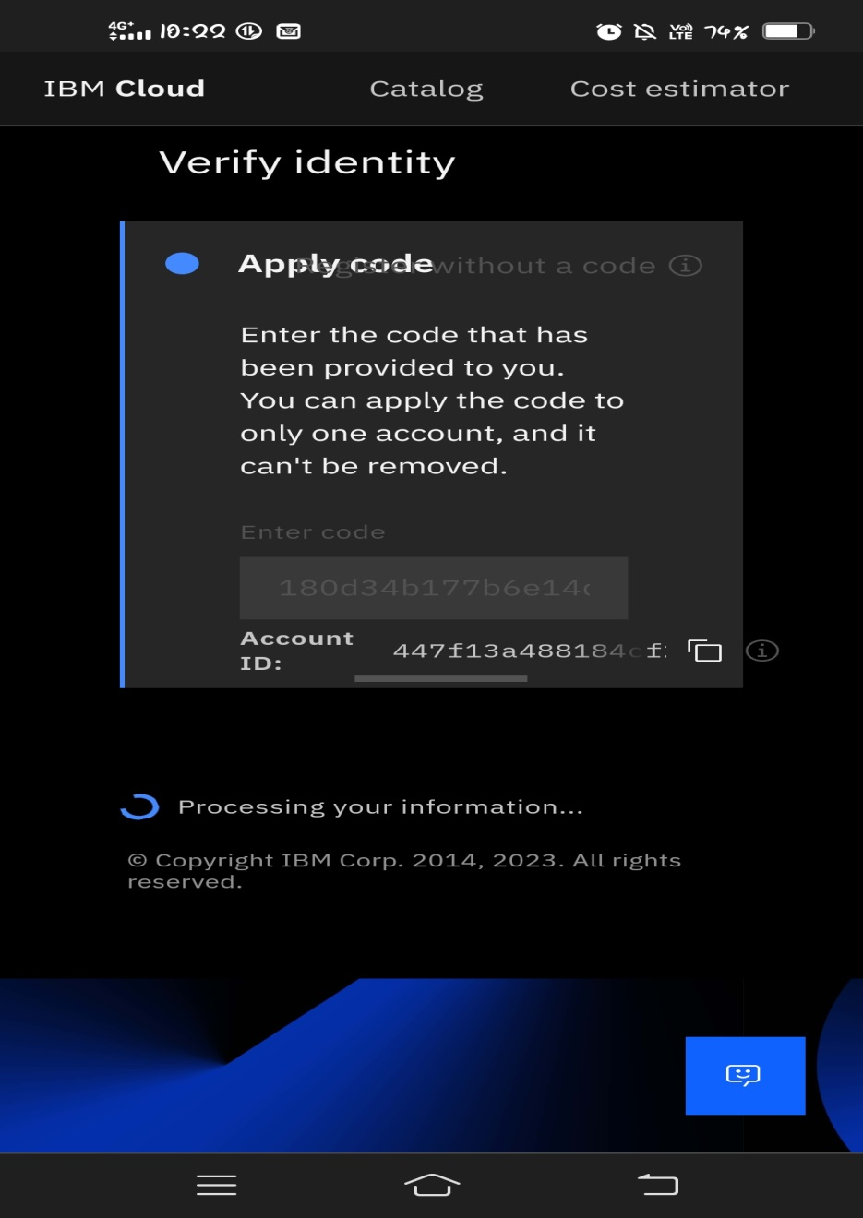
STEP 2: Accept all the conditions and continue to create an account.

Slide 4
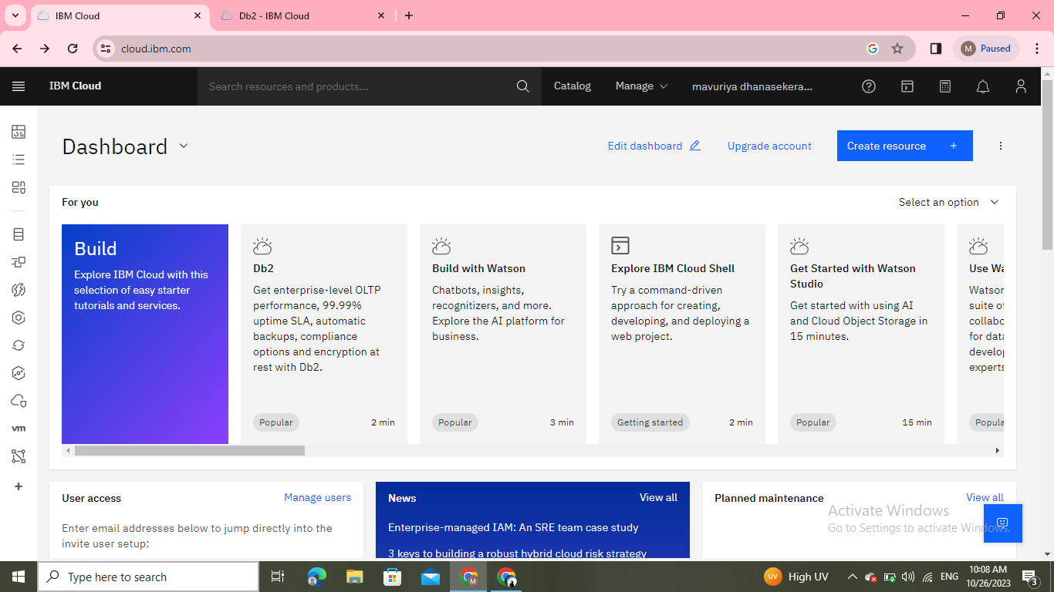
STEP 3: Using mail ID and password to open the IBM cloud.

Slide 5
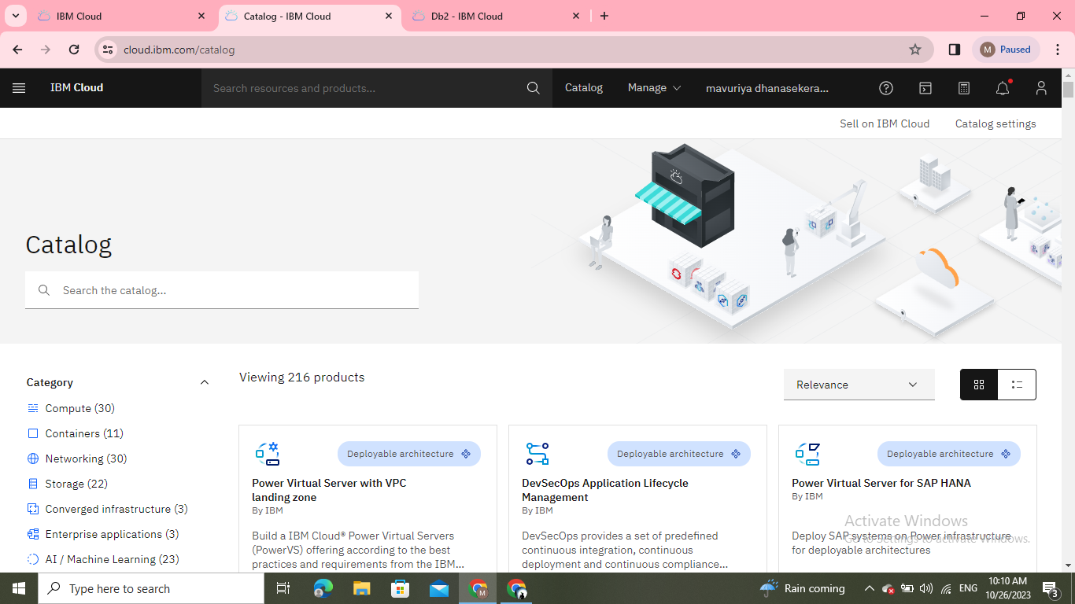
STEP 4: Click the (Browse the service) To open it. Hence, the catalog page will open here.

Slide 6
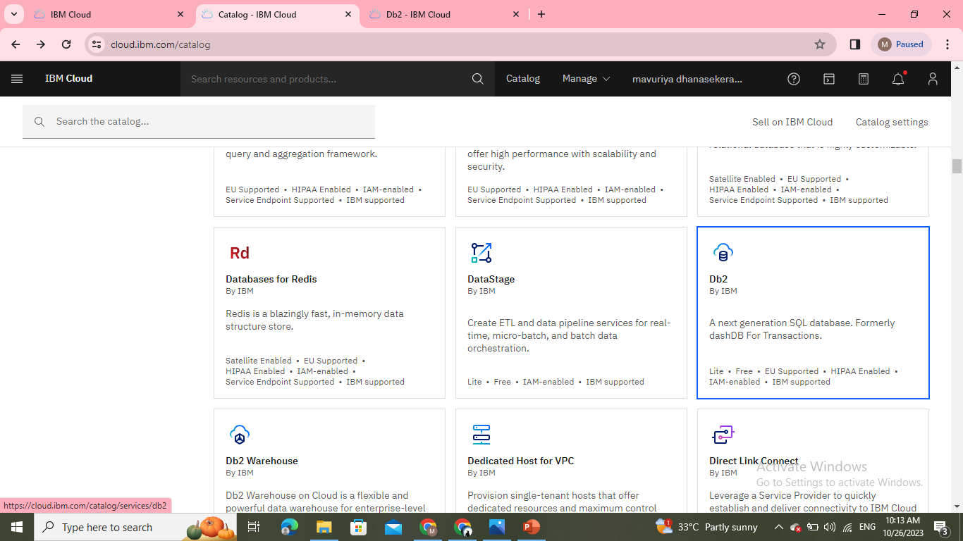
Choose any database in the catalog.

Slide 7
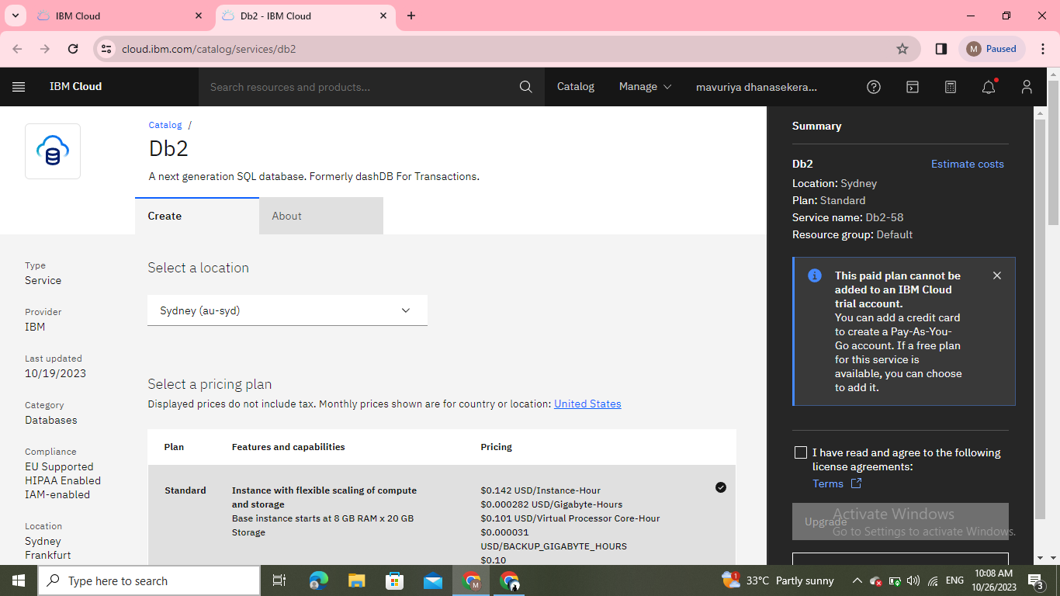
STEP 5: I choose a Db2 database in this catalog.

Slide 8
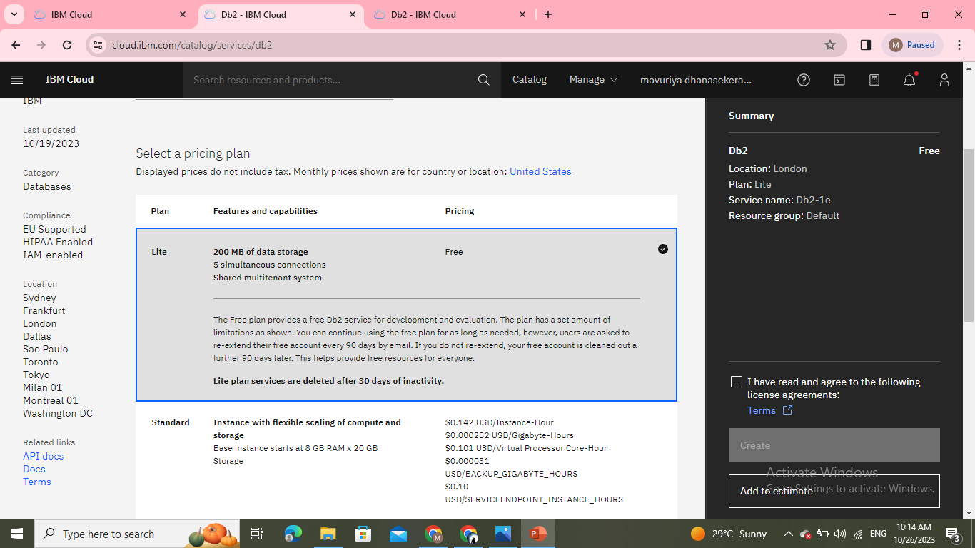
STEP 6: Click the resource list to active the Db2.

Slide 9
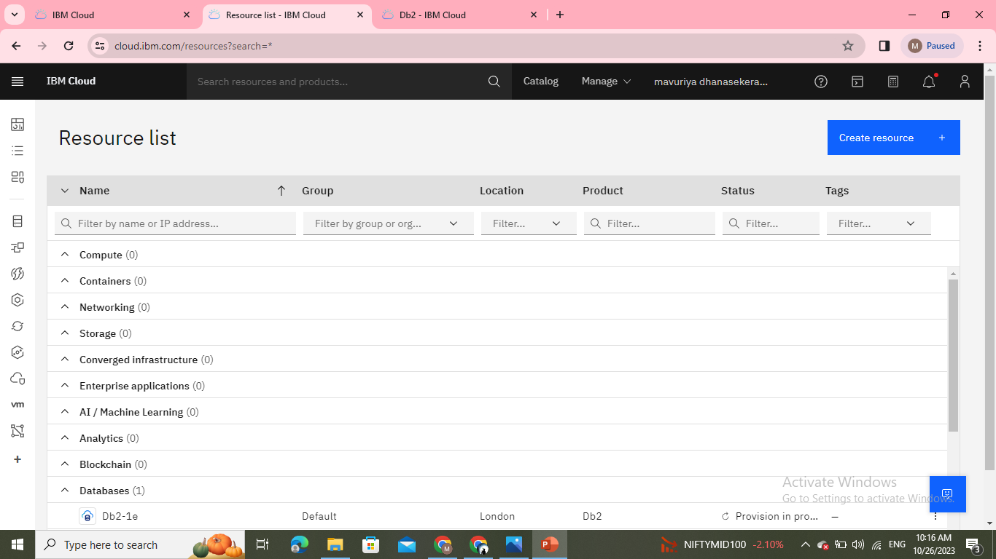
On this page click the resource list to activate the instance database.

Slide 10
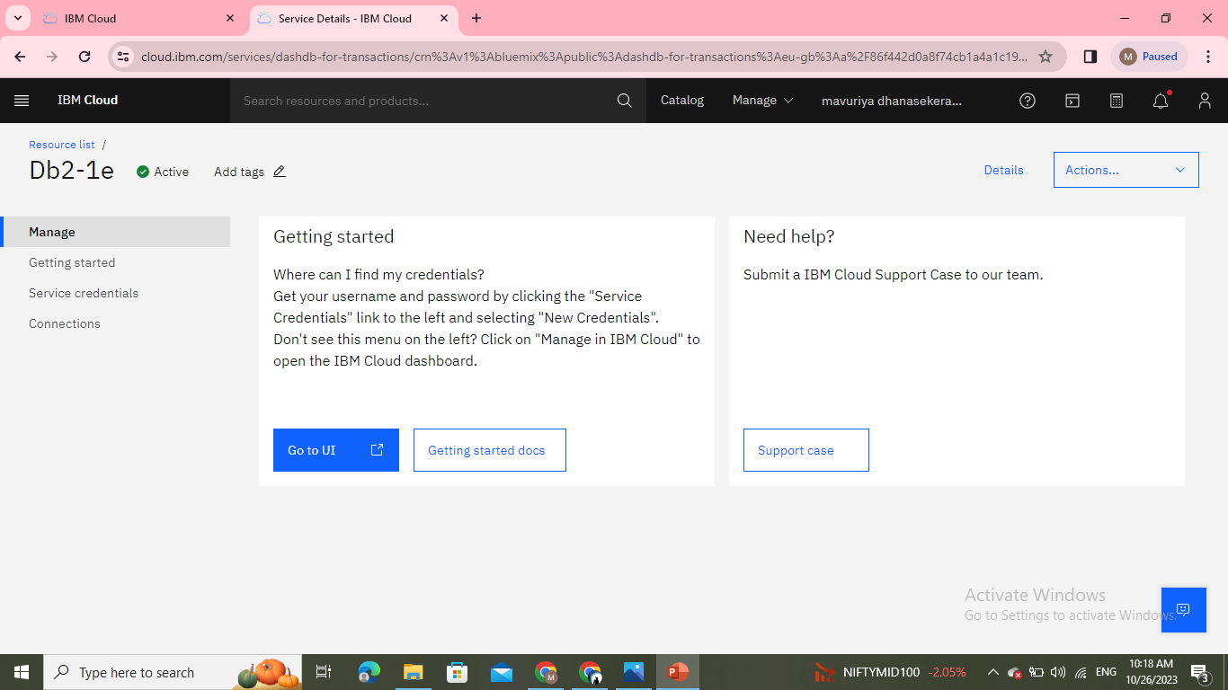
STEP 7: In this Db2 there are 4 options (manage, getting started, service credentials, connections).

Slide 11
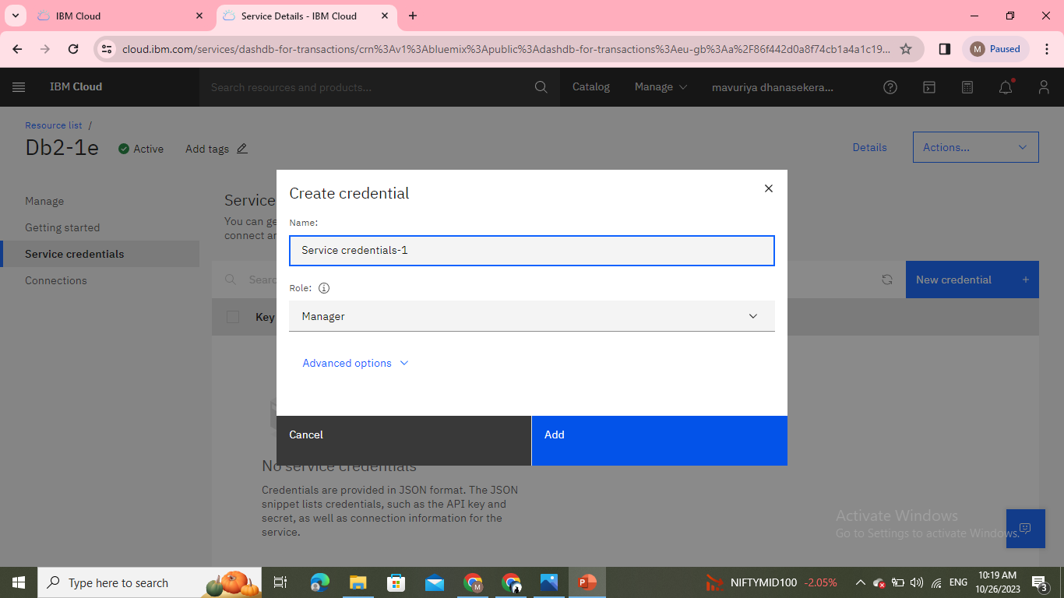

Slide 12
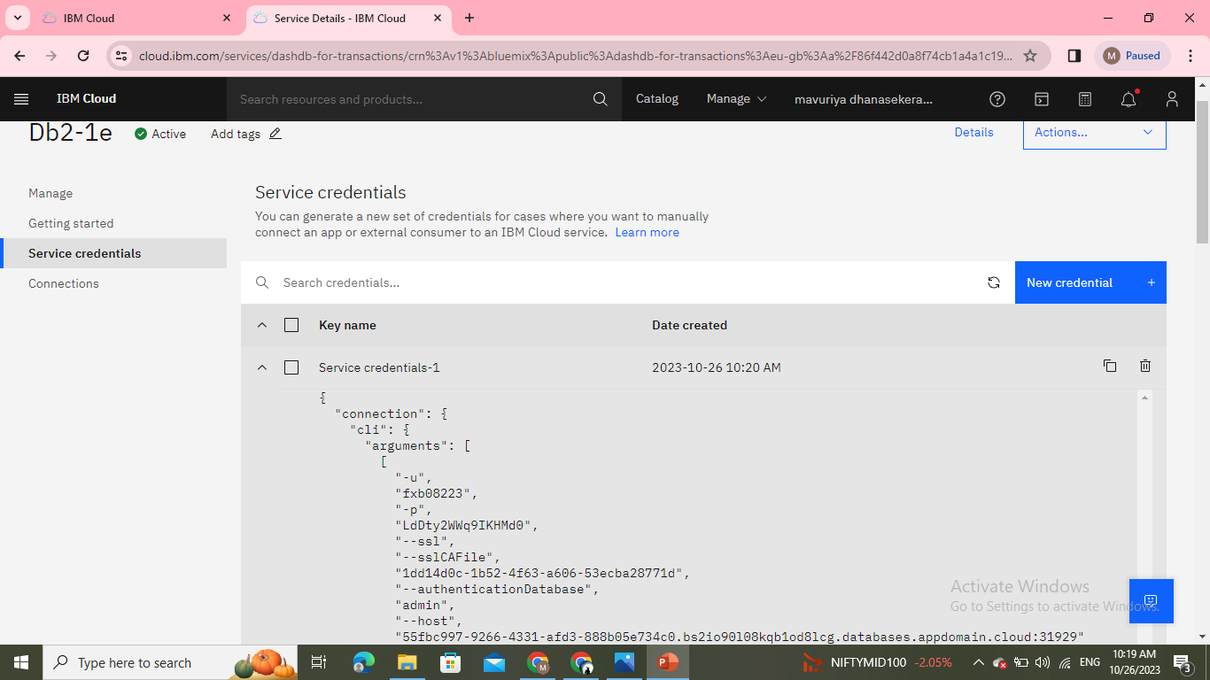

Slide 13
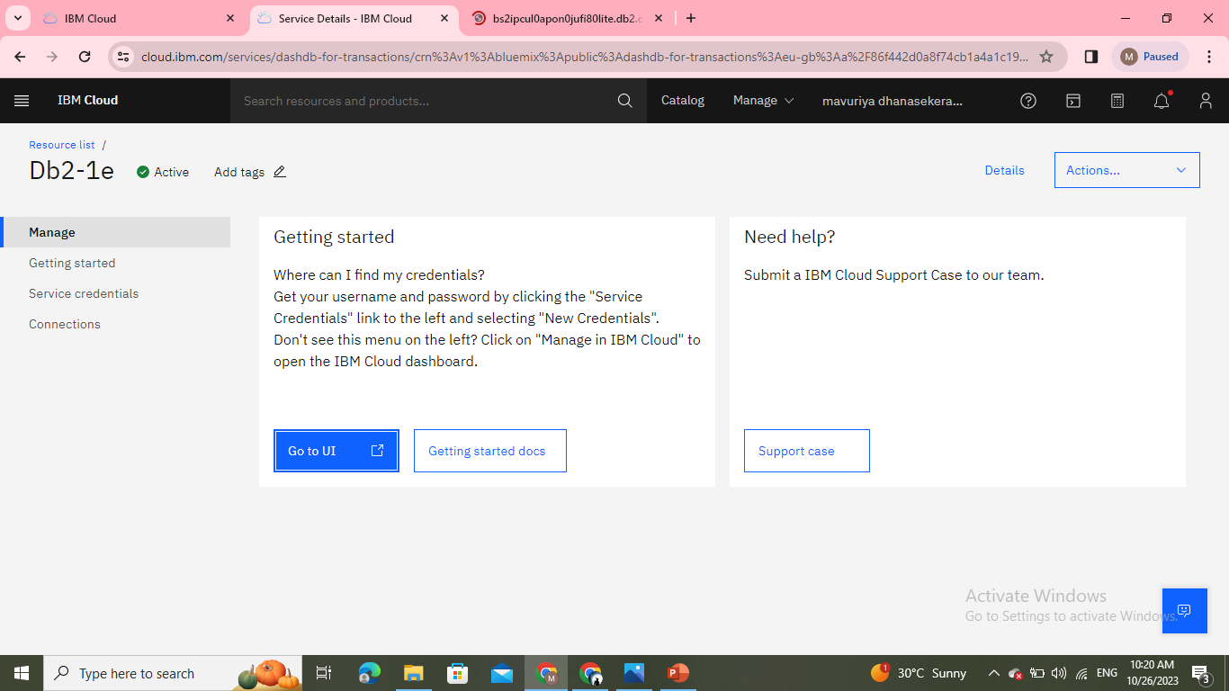
In this (service credentials -1) having a query like a dataset. Click the manage option.

Slide 14
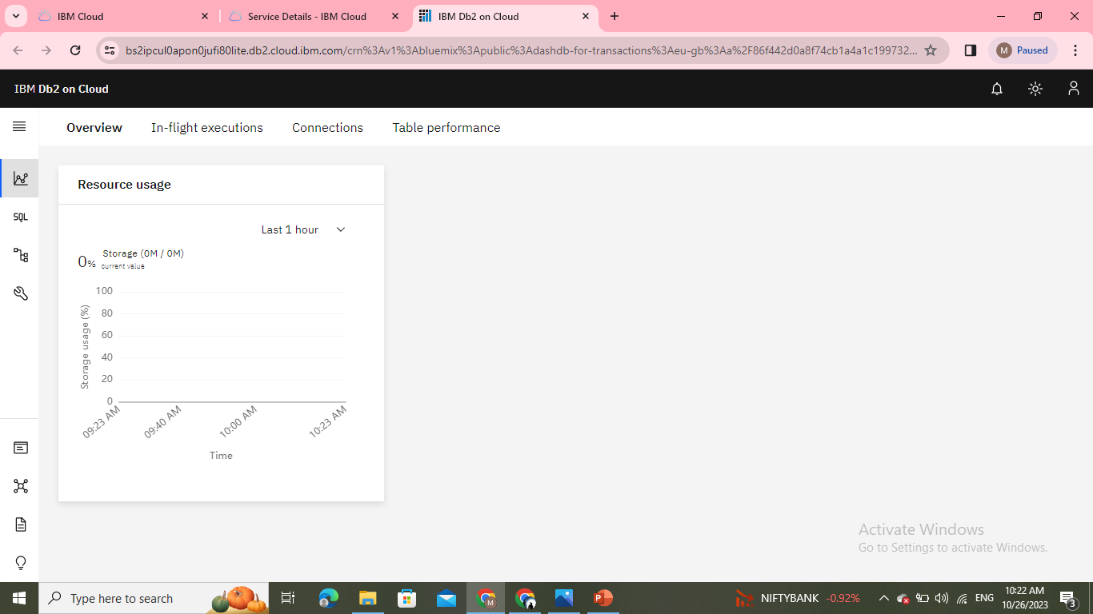
STEP 8: In this manage option click the (go to UI). It will open the IBM Db2 on the cloud page.

Slide 15
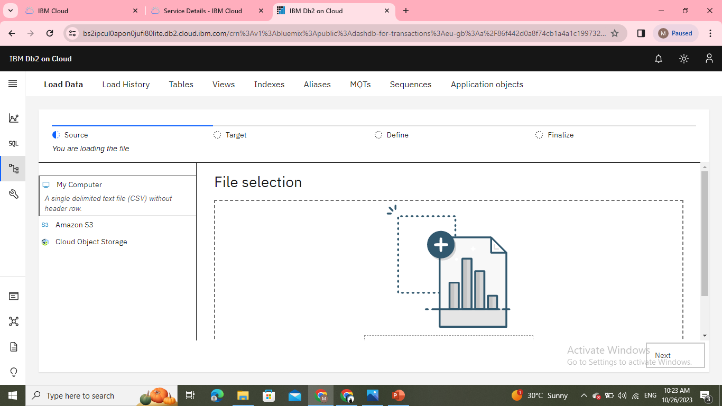
In this file selection, we need to upload the dataset that we downloaded in the browser. I uploaded the healthcare-related dataset(HeartAttackDataset.csv)the uploading file must be in csv or TXT otherwise it will be in a zip file means it will not upload.

Slide 16
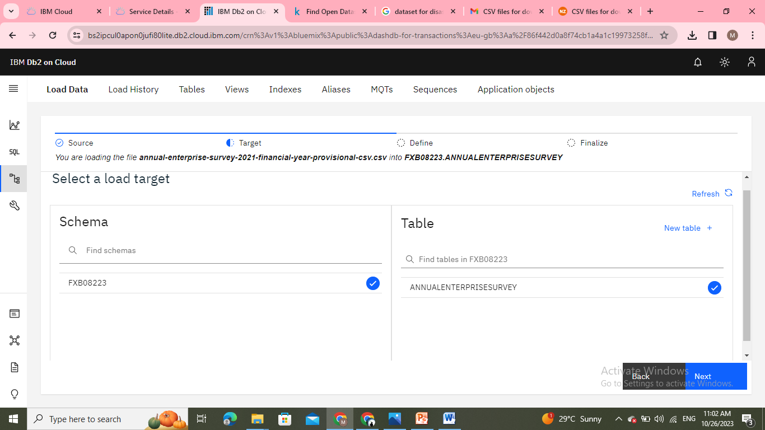
Click the next to open the schema and the table is already created here if need to create the table, click the new table. Click the dataset of (HeartAttackDataset.csv) to show the table definition.

Slide 18
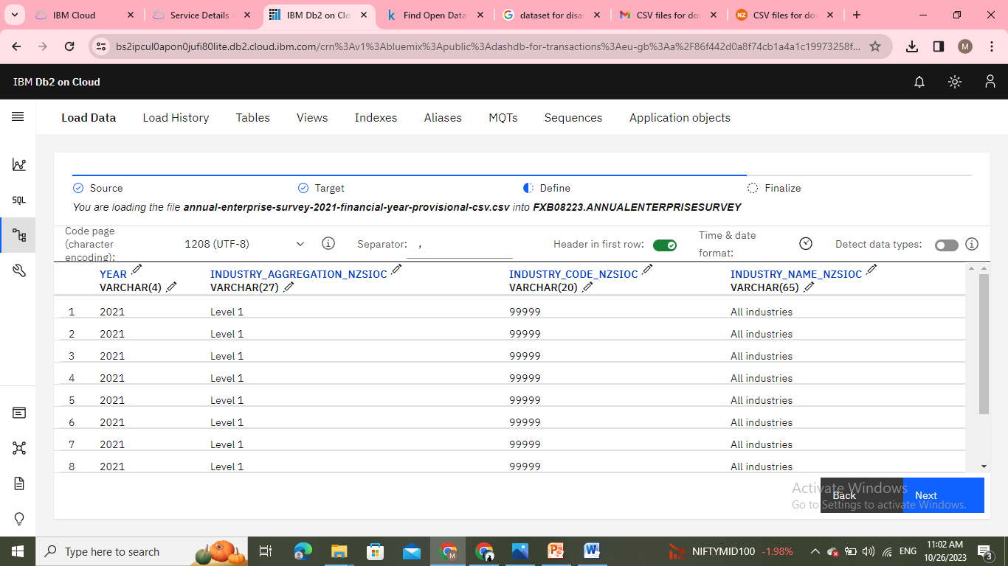

Slide 19
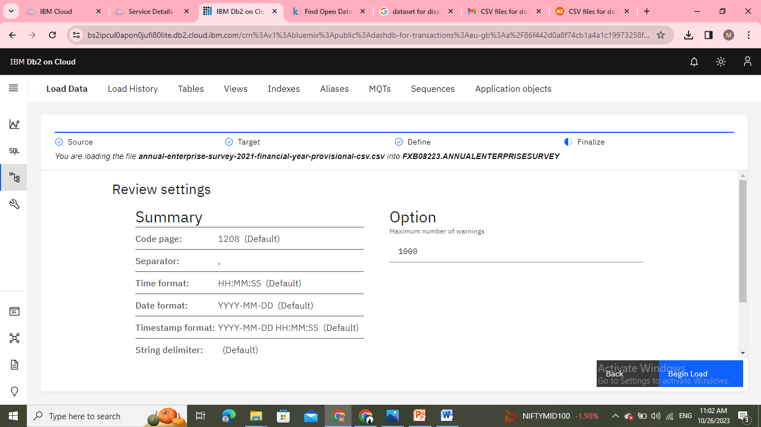
STEP 9 : Here the dataset where created in the table-like row and column format. Finally, we can see the review settings.

Slide 20
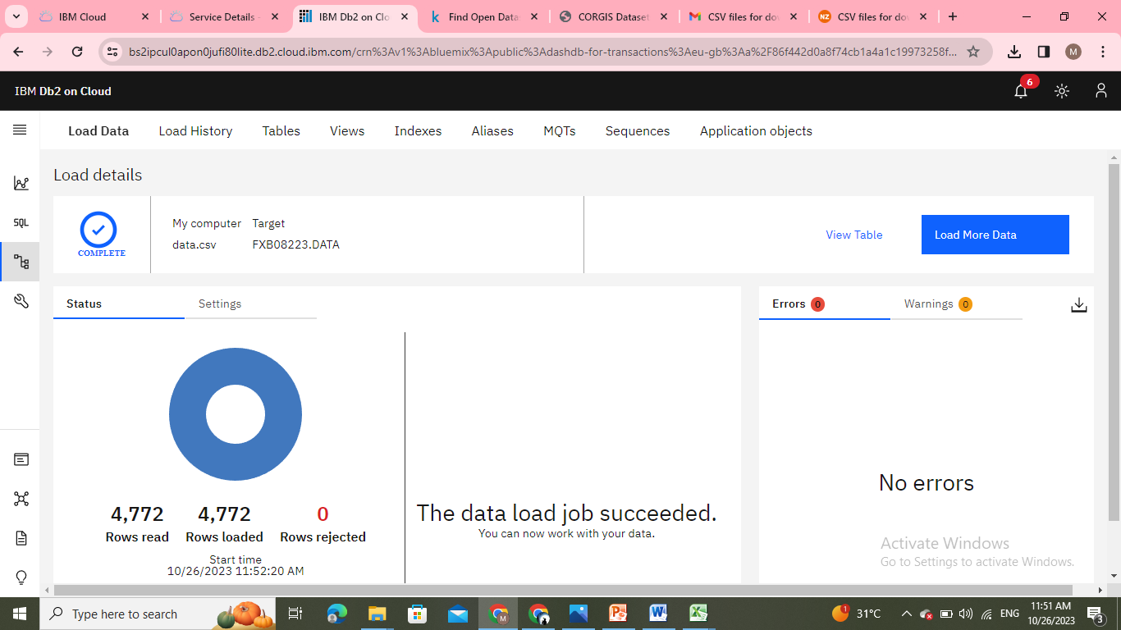
In this 9th step, the data-loaded job is successfully completed.

Slide 21
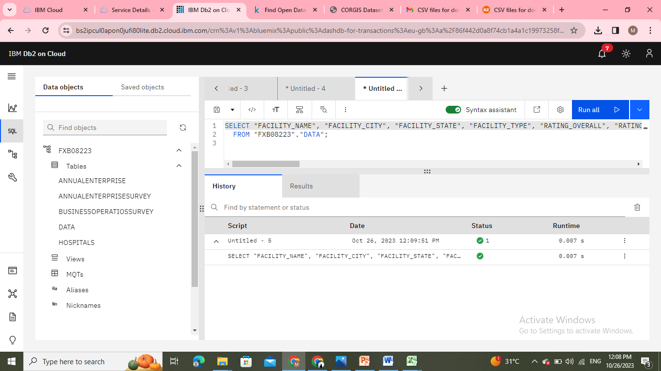
Step 10 : Click the Run SQL option to write the query for the created dataset. To (get the output) click the run selected.

Slide 22
Again go to the resource list to create the storage.

Slide 23
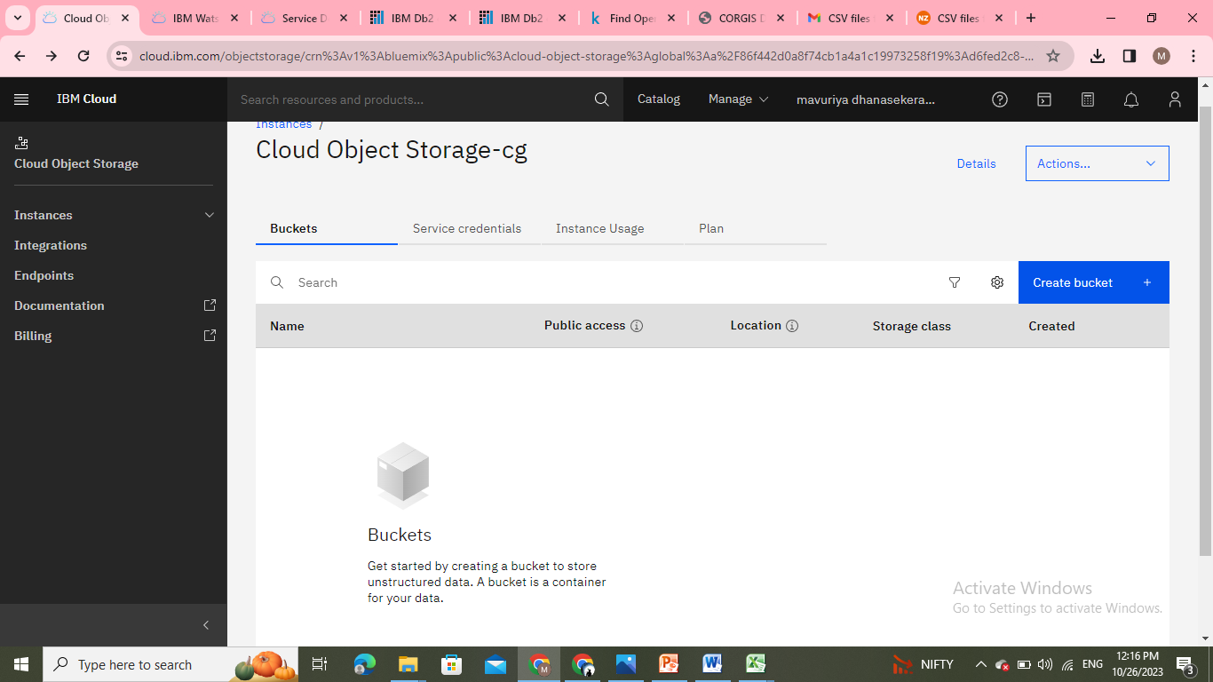
Step 11: Click the object storage in the catalog, for creating the bucket.

Slide 24
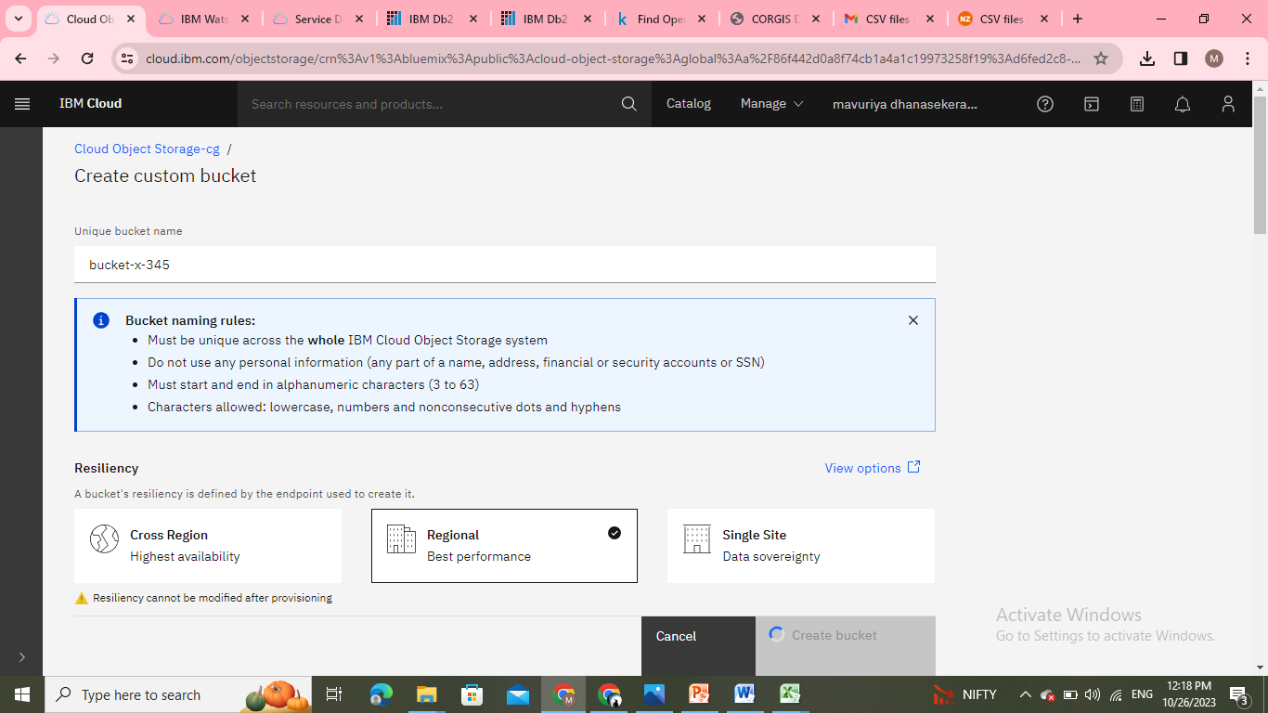
Uploading the dataset in the bucket. We need to give the name for creating a new
bucket Configuration is knowing the bucket details. Permission is only for
the user.

Slide 25
